Slide 1

Inflation Impact on Small Business
Keeping your business on track
Kimberly Kellar
Business Banker , TD Bank
1/22/26
Small Business Workshop

Slide 2

Workshop Objectives
Review how Inflation touches every aspect of the economy, but not every business is affected the same way.
Understand why and how your business might be affected can help prepare for inflation’s impacts on your industry, customers, and workforce.
Learn business solutions that mitigate the impact of inflation, they can have positive operational benefits for the business long term.
Include financial management and tools in your business plan.
Source: AmericanExpress.com

Slide 3
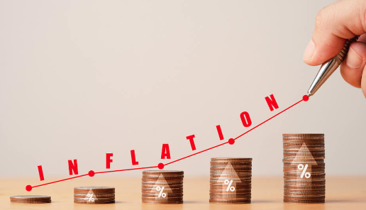
What is Inflation?
Inflation is a rise in prices, which can be translated as the decline of purchasing power over time.
The rate at which purchasing power drops can be reflected in the average price increase of a basket of selected goods and services over some period of time.
The rise in prices, which is often expressed as a percentage, means that a unit of currency effectively buys less than it did in prior periods. Inflation can be contrasted with deflation, which occurs when prices decline and purchasing power increases.

Slide 4

Impact of Inflation on Small Business
Inflation impacts businesses in different ways depending on a variety of factors:
Essential goods and services and sellers with little competition tend to have less issues even as prices rise.
But when consumers have less money left over after buying essentials, they start reprioritizing their spending on nonessentials, or discretionary spending.
Every business should re-evaluate its business plan and operating model when significant market conditions change.
Businesses entering the marketplace with a unique production, pricing or distribution model may have competitive advantage.

Slide 5
Inflation Impact on Operations
Business Operations impacted by inflation include:
Higher costs – raw materials, utilities, wages, etc.
Higher revenue – prices raised within competitive margins
Falling demand – price hikes can impact substitution and demand
Inventory management – cutting back on inventory costs vs. securing inventory at current pricing.
Supply chain disruption – diversifying vendors by need or choice
Interest rates – older debt becomes "cheaper"
Equipment values – purchasing leased equipment may become good value.

Slide 6

Tracking Operations is Key
Keep your financial reporting up to date to track operating trends more closely and better negotiate terms with lenders and investors.
Refer to historical financials to see where budgets and projections may be off and develop responsive strategies.
Sales performance can help you identify developing trends in customer preferences and purchases.
Evaluate every product/service for profit given current factors.

Slide 7
Banking and Finance considerations
Focus on your personal financial position, how your household expenses will be impacted by inflation, and on how your personal and business finances impact each other.
Be on top of potential fraud and speak to your banker immediately if you see suspicious transactions.
Financing a purchase vs. continuing a lease may be a good long-term investment.
Talk to your banker early to identify financing options that fit your business need and operations model. Don't wait until your financial position has been negatively impacted.
Banks offer more than just deposit accounts and financing – look into payment solutions and other services as well.

Slide 8

Tips for dealing with Inflation
Focus on productivity - managing your workforce expenses can get tricky as wages generally rise during inflation, so increasing productivity might require some out-of-the-box thinking.
Retain your workforce - it’s more cost effective to maintain your existing staff than to hire and train new workers.
Retain customers – Try to increase prices incrementally and offer reliable customers longer payment terms.
Rethink cash flow management – automating accounting and scheduling out payments may leave more cash on hand for unexpected cost increases.

Slide 9




Let's get Digital!
Visit the TD Bank Small Business Resource Center for virtual workshops and more:
Video tutorials on a variety of topics including:
Creating a competitive advantage
Preparing a balance sheet
Download templates
Go to https://www.td.com/us/en/ small-business/resource-center/
Learn more about your personal finances and visit the TD Bank Learning Center:
Interactive lessons in less than 10 minutes – from any device!
Topics include credit reports and scores, identity protection, financing higher education, and more.
Go to https://tdbank.everfi-next.net/welcome/td-learning

Slide 10
Additional Resources
TD Economic Long-Term Forecast – December 2022
US News & World Report – Small Business Owners Eye 2023 Warily
SBDC – What Small Businesses Need to Know About Combatting Inflation
Entrepreneur – Six Ways to Protect Your Small Business From Inflation
Better Business Bureau – 5 Ways Your Small Business Can Cope with Inflation
US Chamber of Commerce – How Small Business Owners Can Navigate Inflation and High Interest Rates

